Slide 1

DirectionMQ
By Parth Bhatia, James Cheung, Mst Asma Ul Husna, Tsenguun Tsengel

Slide 2

Vision Statement
Our vision is to provide students and visitors at Macquarie University a seamless and intuitive mobile direction navigating app to make campus life easy. “DirectionsMQ” will be connected to real-time GPS and Wi-Fi location to deliver precise data, this app will provide it’s user , about on foot directions along with vehicle directions that will help users find their way to specific buildings, rooms, and points of interest across campus.

Slide 3
Functional requirements
A
Buildings on campus can be chosen as a destination and the user can select a room in the chosen building as the specific destination.
B
Waypoints can be added whilst on a route which does not override the original destination and merely redirects the route to include the waypoint.
C
Routes can be saved and labelled such that we can choose from preloaded routes for a destination. Meaning a single destination can have multiple routes [best for scenic/ best for wet weather etc.]

Slide 4
Non - Functional requirements
Adding waypoints requires less than 3 secs to load the route to the new sub-destination in order for navigation to be efficient for the users of the ‘DirectionsMQ’.
Saved/preloaded routes and destinations can be accessed while the application is not connected to the internet.
Users can upload routes which are scrubbed of any identifying information including metadata in order to protect the privacy and security of applications’ users.

Slide 5
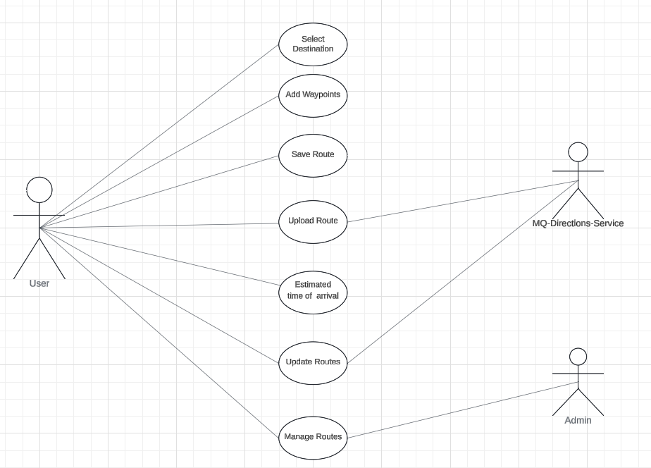
Use Case

Slide 6
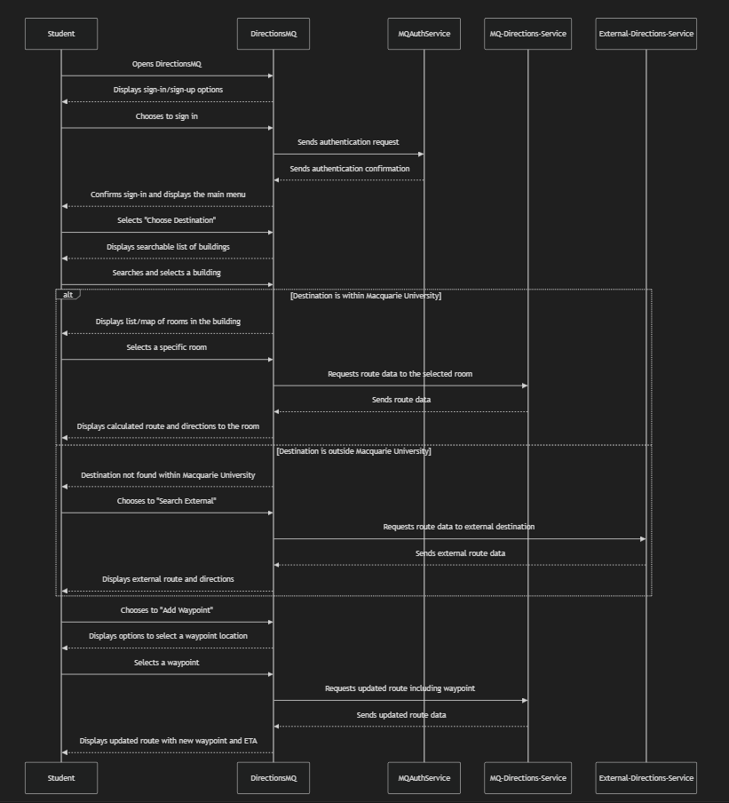
Interaction diagram

Slide 7
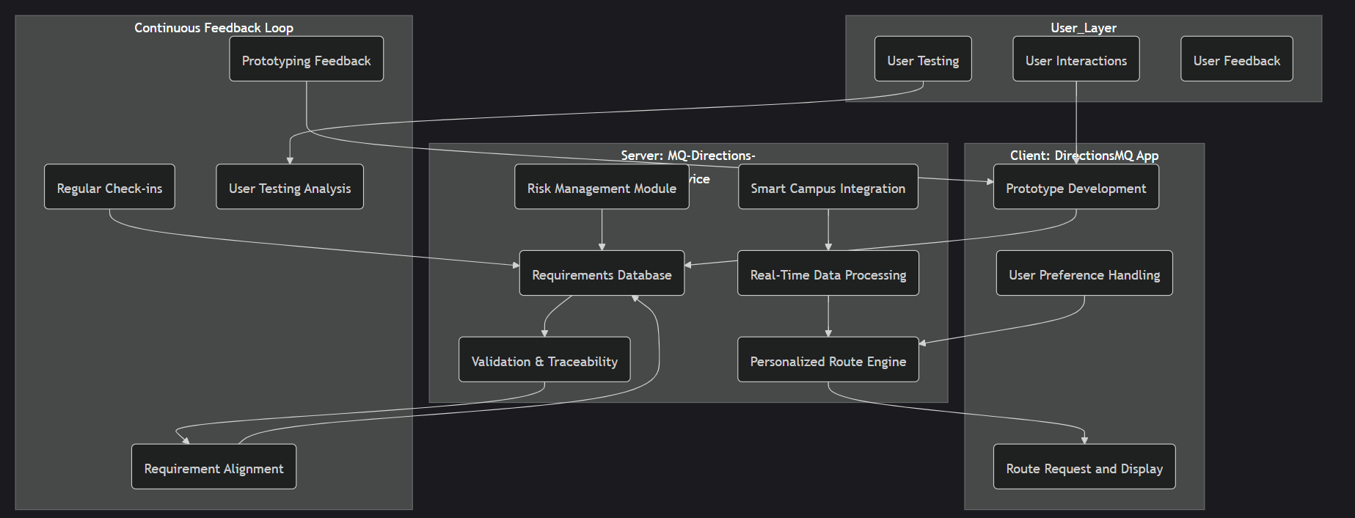
Architecture

